Slide 1


The prediction of inadequate colon capsule cleansing: a cohort selection guided by CC-CLEAR
GE Port J Gastroenterol, Published online: September 14, 2021; DOI: 10.1159/000518588
Rui de Sousa Magalhães (1,2,3); Pedro Boal Carvalho (1,2,3); Bruno Rosa (1,2,3); Maria João Moreira (1,2,3); José Cotter (1,2,3)
1. Gastroenterology department, Hospital da Senhora da Oliveira – Guimarães
2. Life and Health Sciences Research Institute (ICVS), Escola de Medicina, Universidade do Minho, Braga, Portugal
3. ICVS/3B’s, PT Government Associate Laboratory, Guimarães/Braga, Portugal
Background
CC-CLEAR is the new scale to report quality of colon cleansing in colon capsule.
De Sousa Magalhães R, Arieira C, Boal Carvalho P, et al. Gastronintest Endosc. 2021 Jan;93(1):212-223. doi: 10.1016/J.gie.2020.05.062

Slide 2
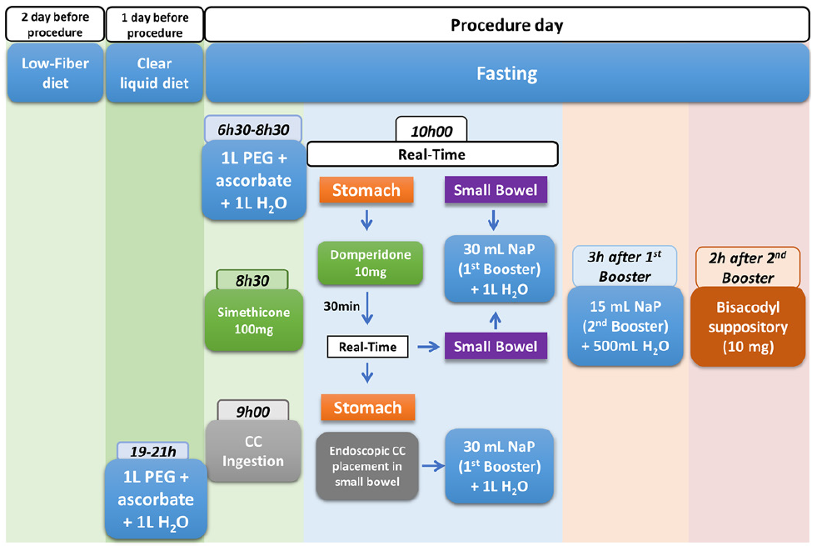

In order to optimize adequate cleansing rate in colon capsule, it is key to identify risk factors for a sub-optimal colon preparation.
Colon preparation protocol for colon capsule
To define predictive factors for inadequate bowel preparation in colon capsule, according to CC-CLEAR.

Slide 3

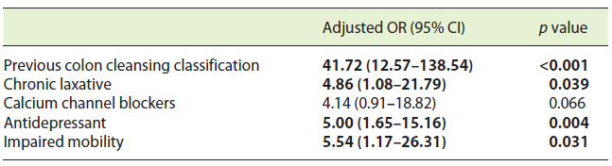
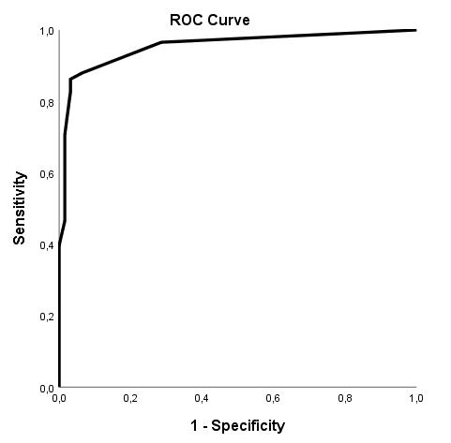
Results
Multivariate logistic regression model
167 consecutive colon capsules
Accurate predictors
Inadequate CC-CLEAR
AUC ROC curve 0.937
95%CI[0.915-0.992] p < 0.001
Clinical Impact
Categorization of patients at major risk for inadequate colon capsule cleansing
Optimization of the colon cleansing protocol, such as:
Stricter diet
Classic high volume PEG purgative
Adjunctive drugs
Educational sessions

